Slide 1
Best Practice on Visual Elements
Subject-Web Design & Development I
Exercise 3
Submitted By : 1. Kruti Patel
2. Pooja Vyas

Slide 2
Areas / Functionalities
Search Box
Gallery
Calendar

Slide 3
Four websites Using these functionalities
Website with similar content
Website with different content
Priceline.com
Agoda.com
Rentpanda.com
Bestbuy.com

Slide 4
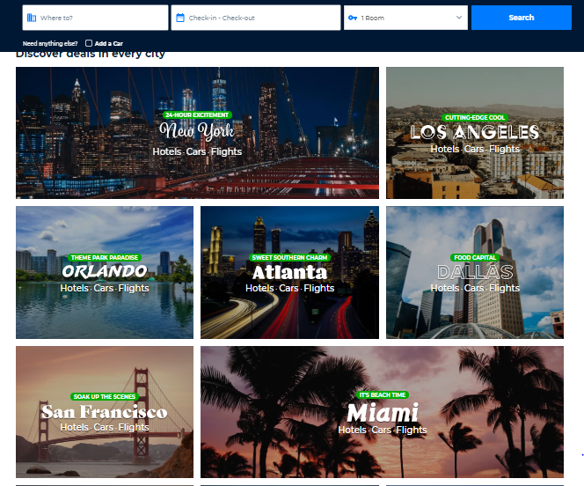
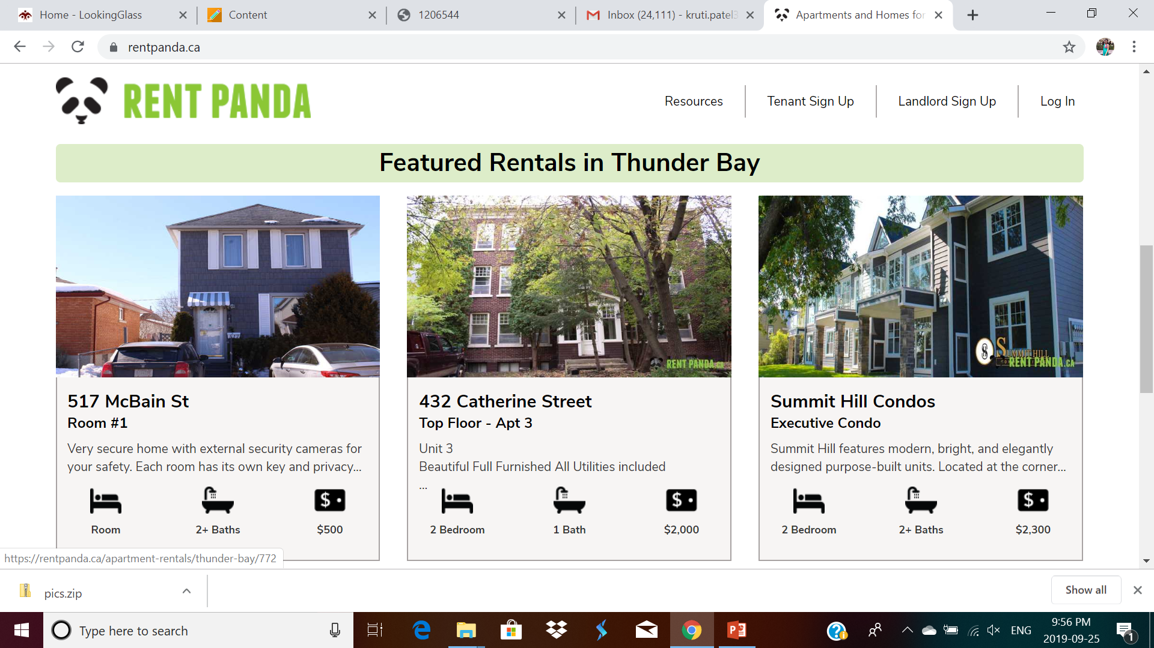
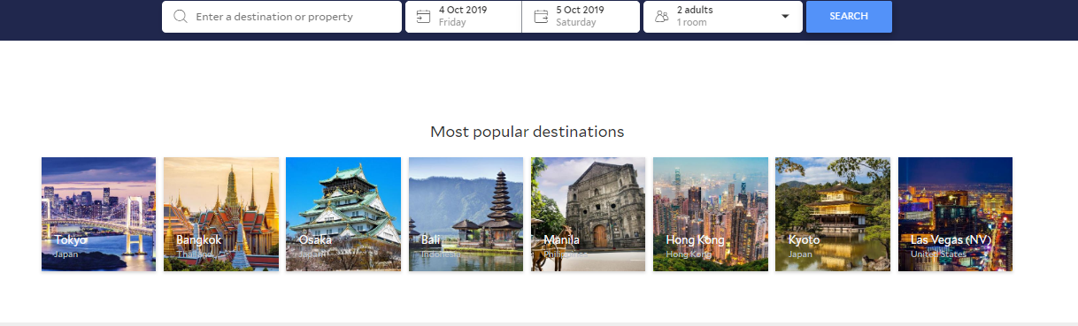
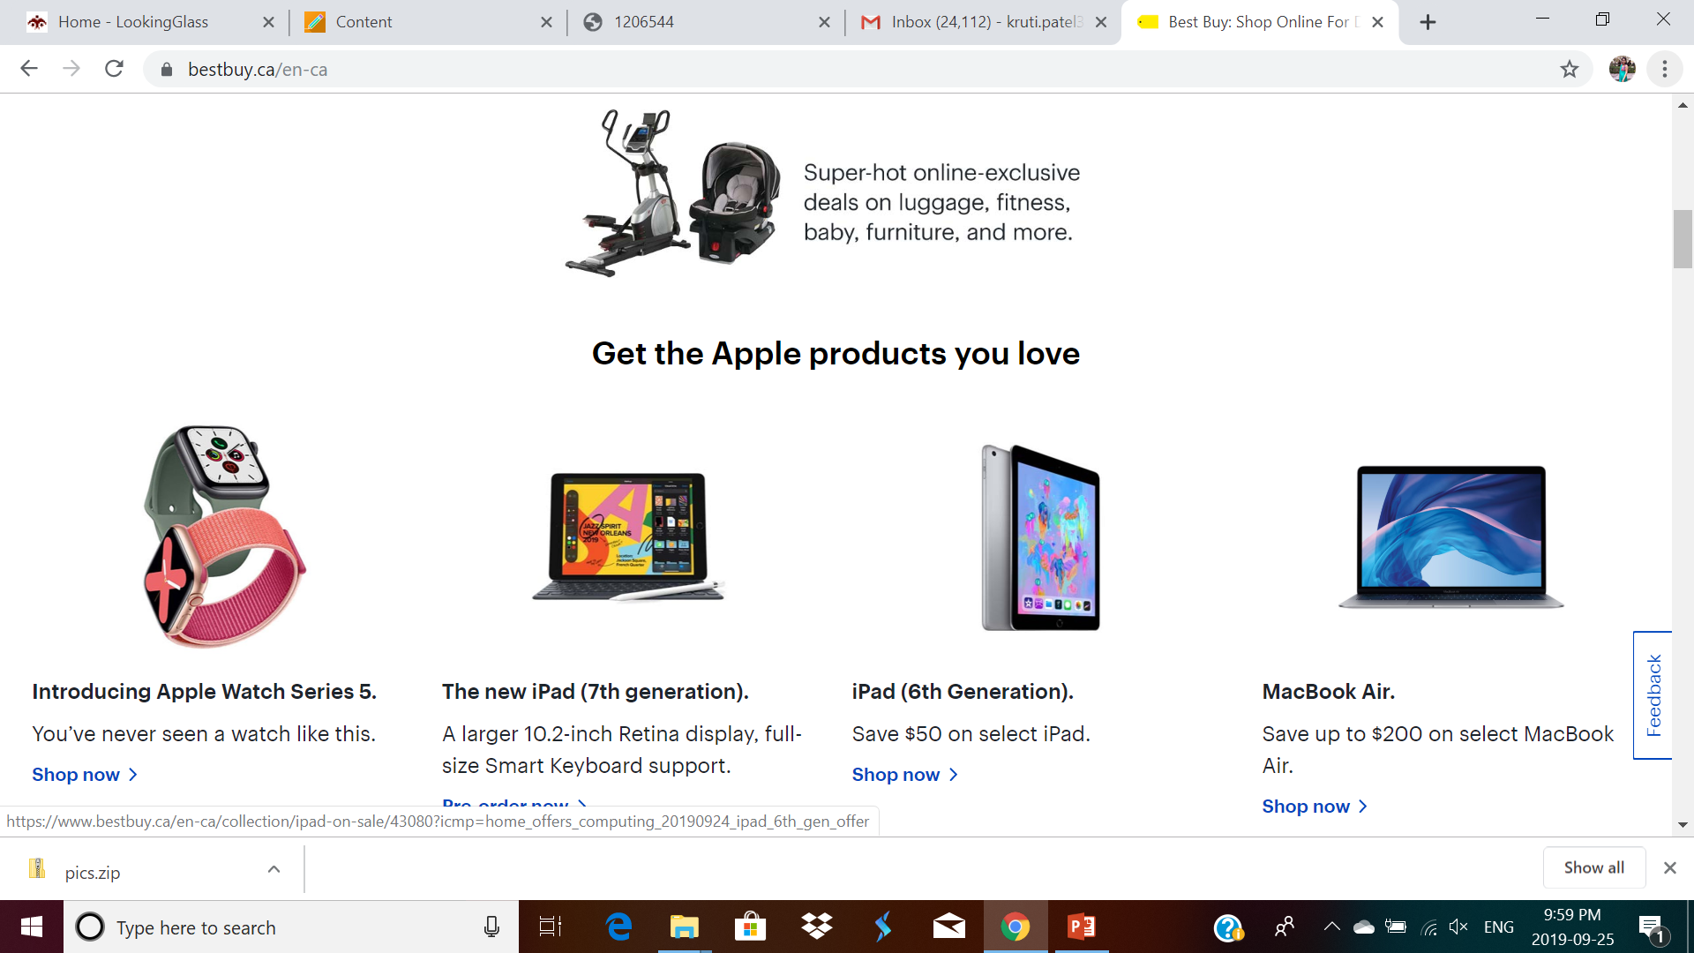
First Functionality-Gallery
Priceline.com
Rentpanda.com
Agoda.com
Best Buy.com

Slide 5


Website with similar contents
Priceline.com
Priceline.com and agoda.com both website has used “GALLERY” for same purpose that is they have used gallery for visiting different cities and exploring them which makes easy for the customer to decide their destination.
Agoda.com

Slide 6
Website with different Content
Rentpanda.com
Rentpanda.com uses “GALLERY” for displaying various rental properties available in the city which makes the user to finds the rental house easily. Whereas Bestbuy.com also uses “GALLERY” for display the best deal available recently and price of the items to attract the customers.
Bestbuy.com

Slide 7
User interface element of the functionality
Image Gallery-User interface
Search box
Calendar
Auto-suggestion mechanism
Drop-down list
Use filter to search precisely
Slot picker
Availability viewer
Text-link
Image link

Slide 8
One that requires user interaction
Search box
Search box is the first place where user will go and search for desire outcome.
When users encounters complex sites ,they will immediately look for a search box to get their final destination quickly and painlessly.
It is combination of input field and submit button
Search box plays an important role in make the website most popular.

Slide 9
Gallery
Rentpanda.com
Priceline.com
In Rentpanda.com, gallery is used for displaying the houses for rent with full details of the houses.
In priceline.com, gallery is used for highlighting deals in every city.
Bestbuy.com
Agoda.com
In Bestbuy.com , gallery is used for the displaying the hottest deals and latest tech with the features and specification
In agoda.com, gallery is used to show the most popular destinations.

Slide 10
Search box
Rentpanda.com
Priceline.com
In Rentpanda.com, search box is used as filters by selecting different requirements of house which customer can filter and search accordingly.
In priceline.com, search box is simply a input field and has auto-suggestion feature to select the desire result for a search.
Bestbuy.com
Agoda.com
In Bestbuy.com , search box is used to search technology product and has auto-suggestion feature on.
In agoda.com, search box is gives the list the destination or property that can be used for search.

Slide 11
Calendar
Rentpanda.com
Priceline.com
In Rentpanda.com, calendar is not used in this website. They use signup form to register and become a member.
In priceline.com, calendar is used for check-in and check-out for the room.
Bestbuy.com
Agoda.com
In Bestbuy.com, calendar is not used in this website. They use signup form for getting hottest deals.
In agoda.com, calendar is used to book tickets and hotel rooms.

Slide 12
Pros &cons of Element
PROS
CONS
Image gallery
makes user interface from interactive for user then text.
Search Box
It makes job of user easy to find the desired result.
Calendar
Booking tickets and hotel rooms in a calendar are more reliable than booking using an UI.
Image gallery
Images take lots of space for storing HD image
Search Box
Sometimes auto-suggestion gives some irrelevant suggestion that might irritated the user
Calendar
Sometimes, It select the date on its owns

Slide 13
Important factors for defining website layout
Website responsiveness speed
Website should response fast otherwise it may disappoint the user and he never visit that website again
Usability
The Website should be able to operate by all type of users.
Website Content
Website content used be verified , relevant and contains all information about the website.
Images & Video Content make user more understandable and user get more attracted towards the website.

Slide 14
Thank you

